Slide 1
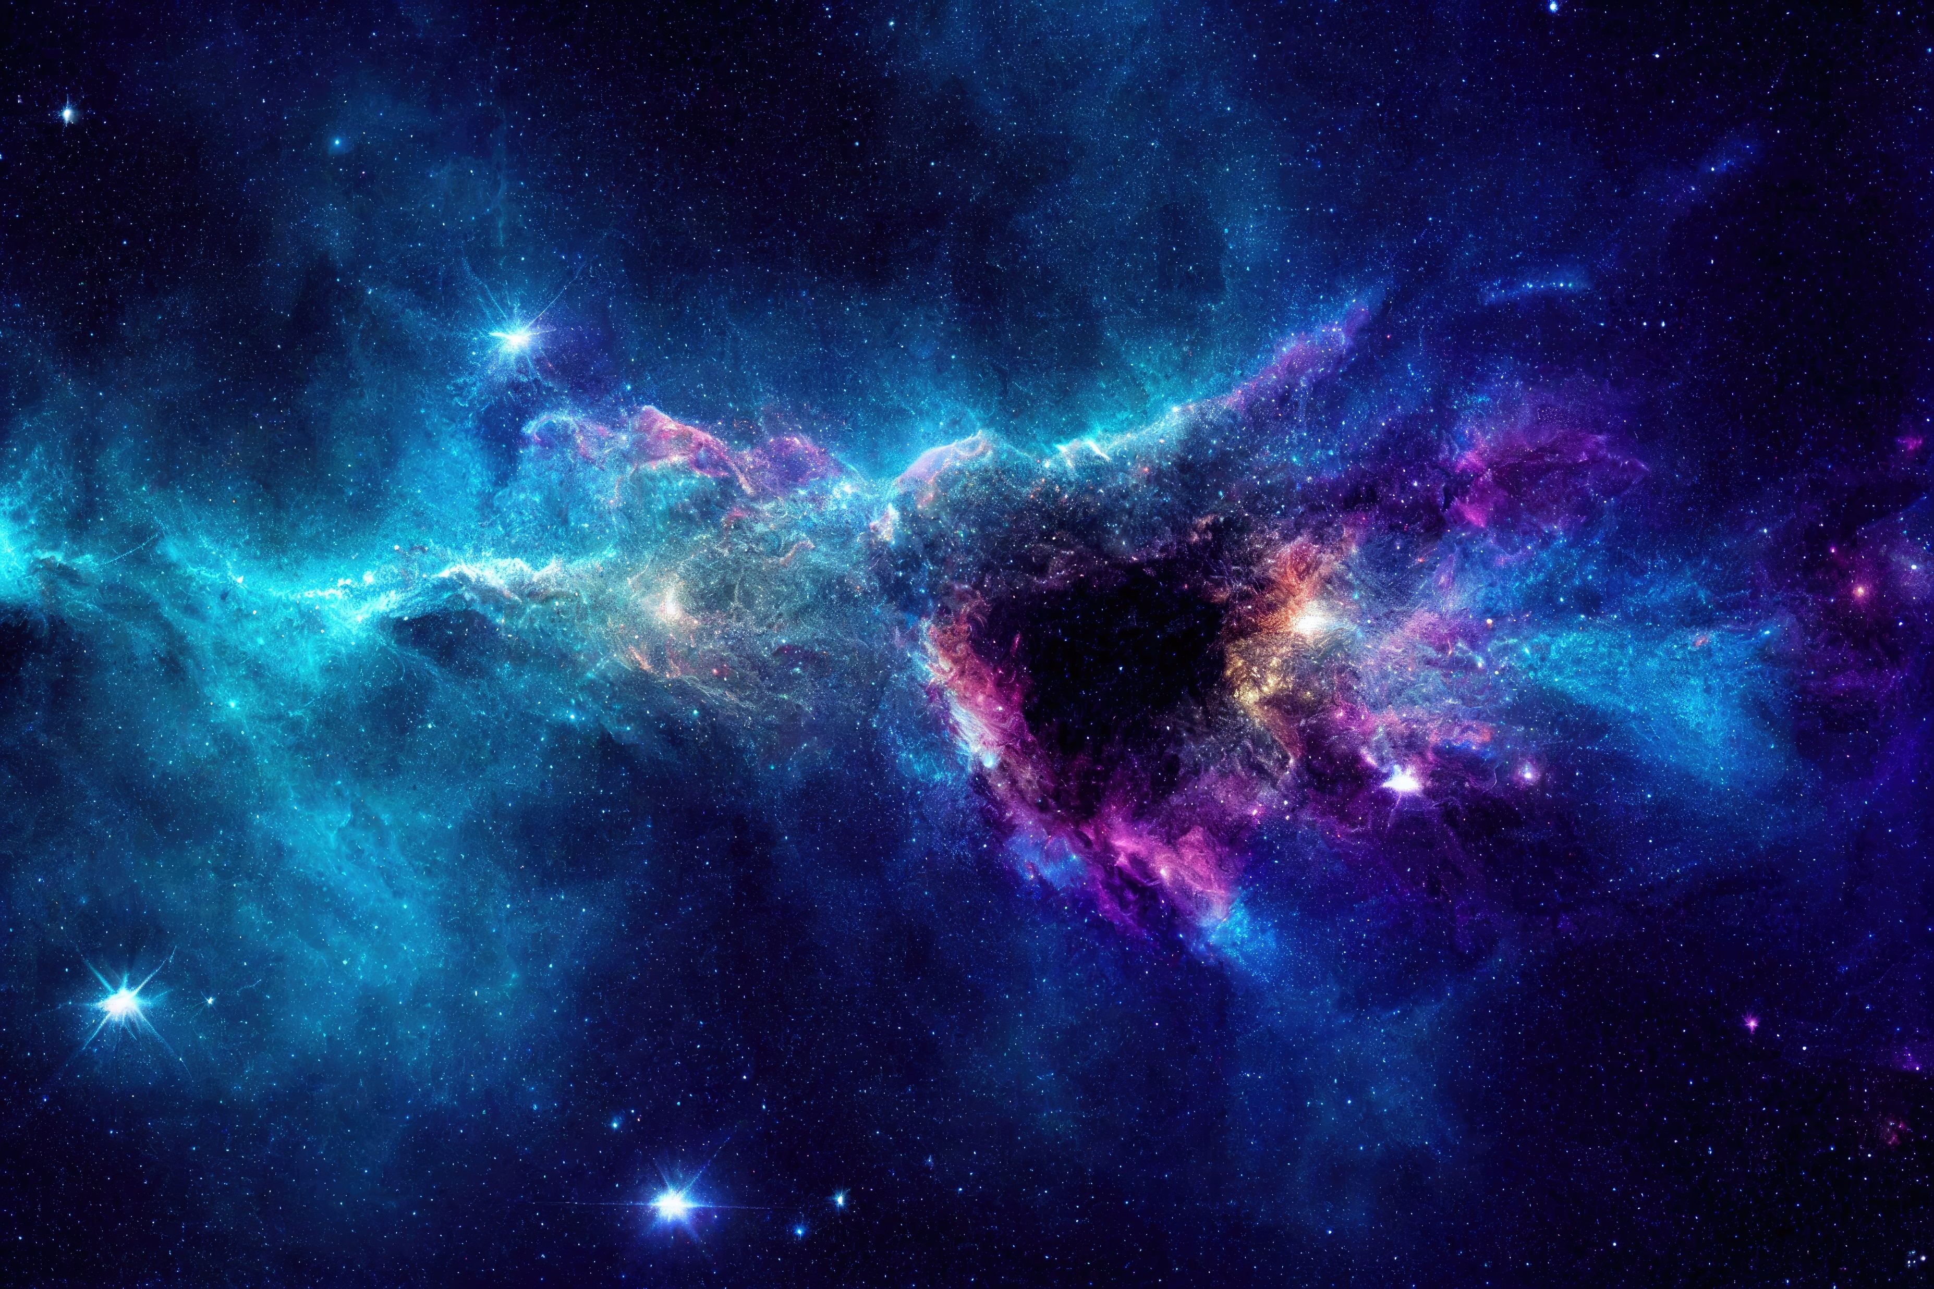

“Across the Cosmic Sea: The Quest to Find Distant Worlds”
Challenge: Chronicles of Exo Planet Exploration
CELESTIAL
T E C H Z Z Z
Niranjana R Nair - lV
Nakshathra R - Vll
Ishitha V - lV
Nirav Krishna - V
Aashika A R - Vll

Slide 2
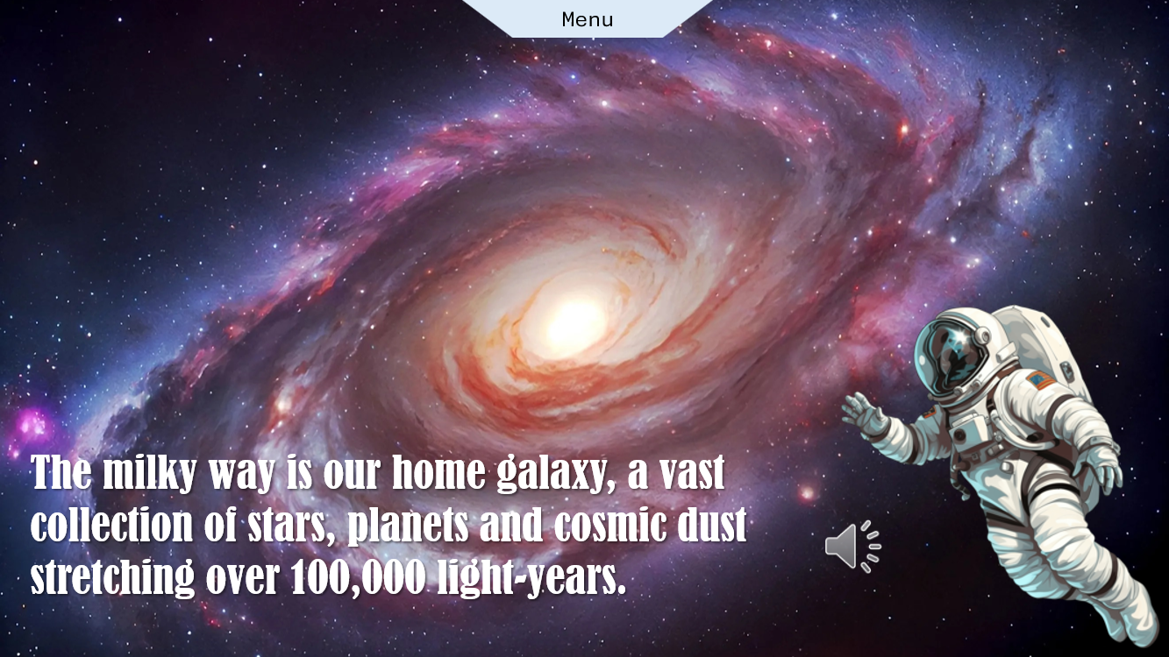
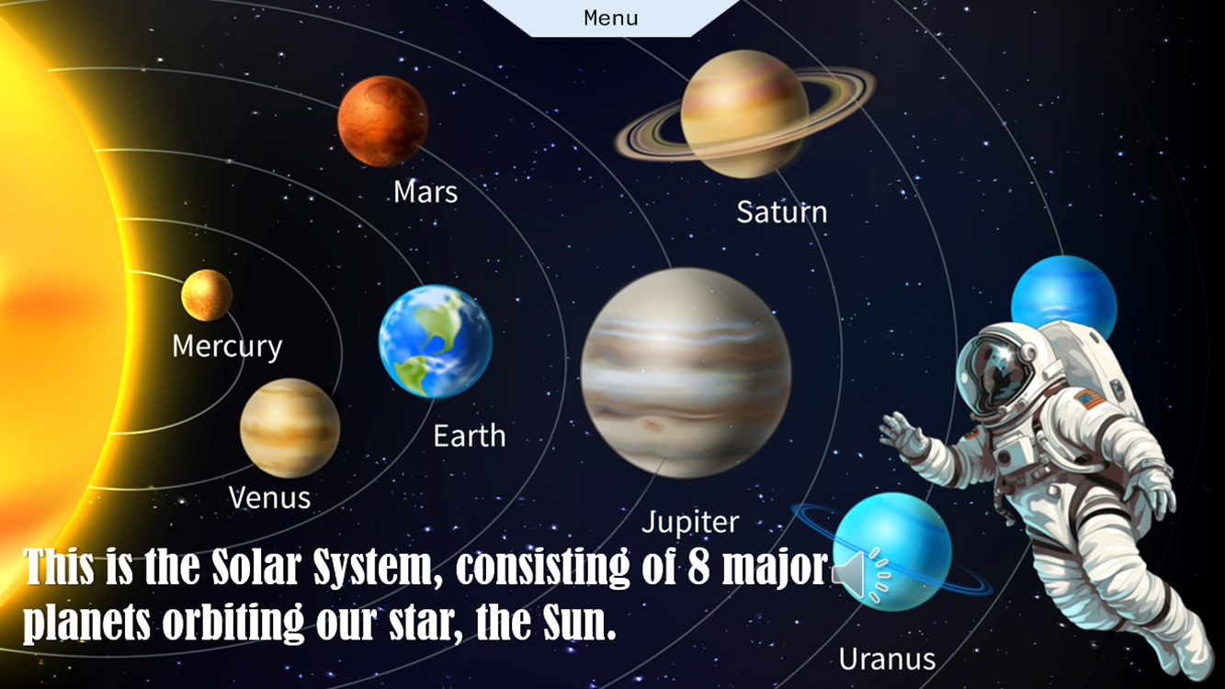
Welcome to this demo presentation, which introduces the fascinating subject of exoplanet exploration and provides an overview of the structure of our full presentation. This exploration takes us from our home galaxy, the Milky Way, to the boundaries of known space , where distant exoplanets orbit stars light years away. The presentation is designed to take you on a journey from understanding our galactic neighbourhood to exploring new worlds that may one day reshape our understanding of the universe. We begin our presentation with an introduction to the Milky Way galaxy, our home in the vast universe. This spiral galaxy, made up of billions of stars, is where our solar system resides.

Slide 3
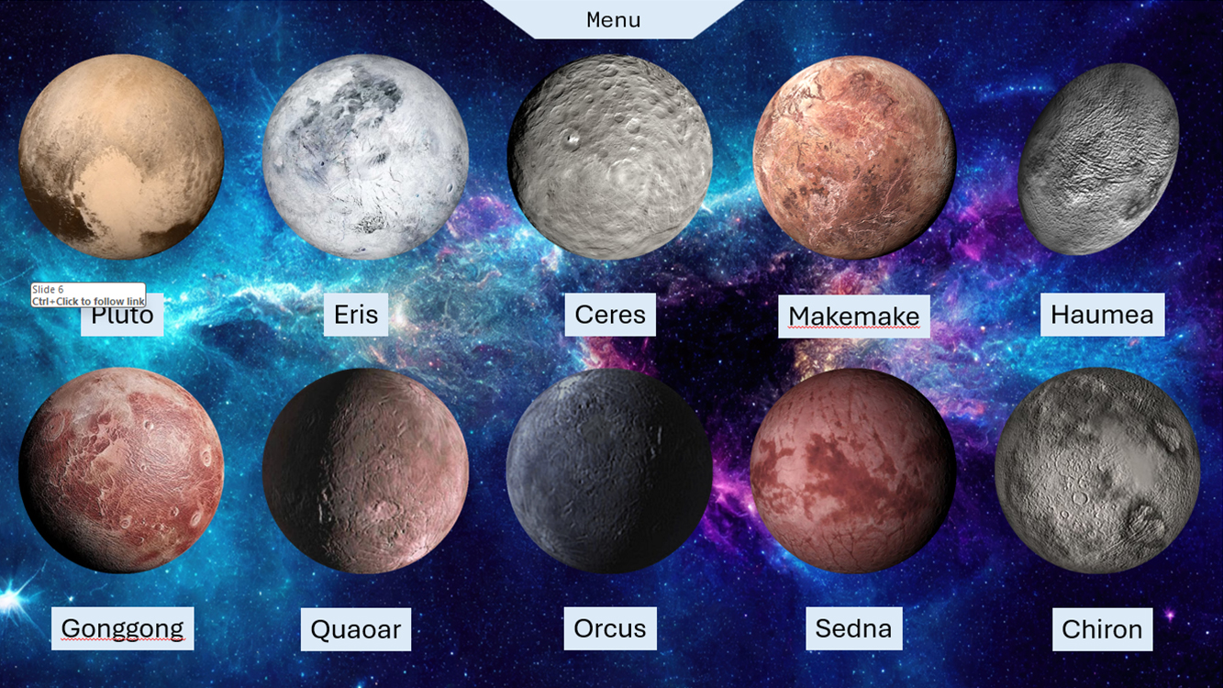
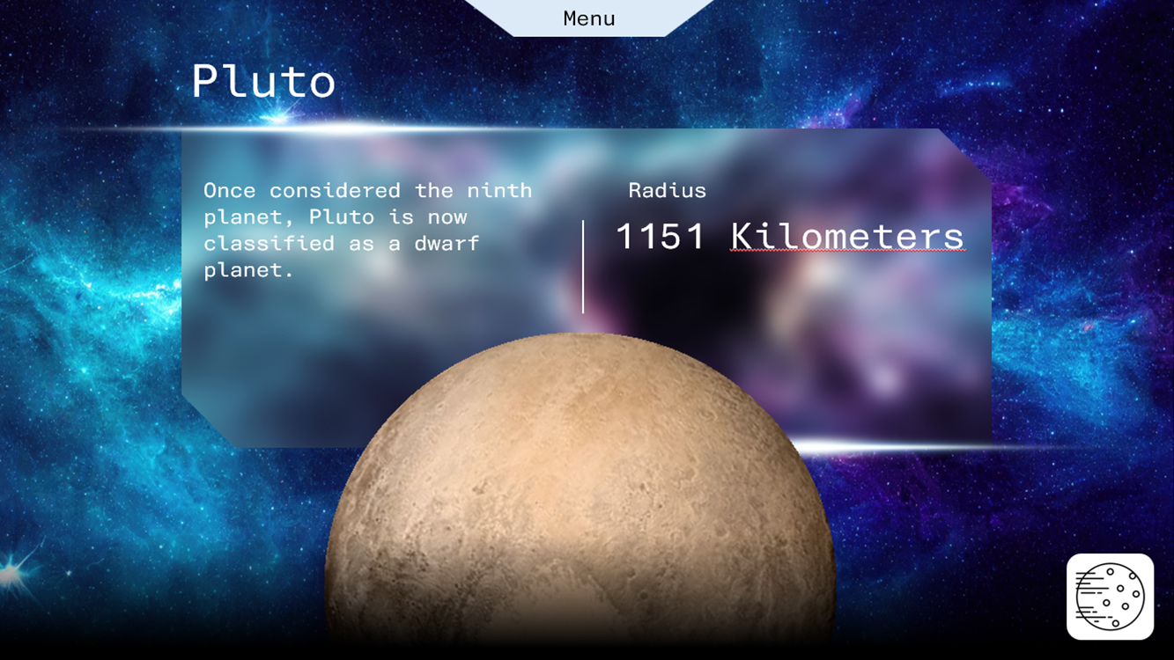
The following section of the presentation introduces 10 dwarf planets within our solar system. These celestial objects, while smaller than the major planets, hold critical importance in our understanding of planetary formation and characteristics. On this slide, each dwarf planet is represented by a clickable button with a picture. These buttons act as hyperlinks, which when clicked, take you to individual slides dedicated to each dwarf planet, offering a deeper dive into their specific traits.
For example, you’ll find information about Pluto, one of the most famous dwarf planets, as well as lesser-known ones such as Eris and Haumea. Each of these slides contains details about the planet.

Slide 4
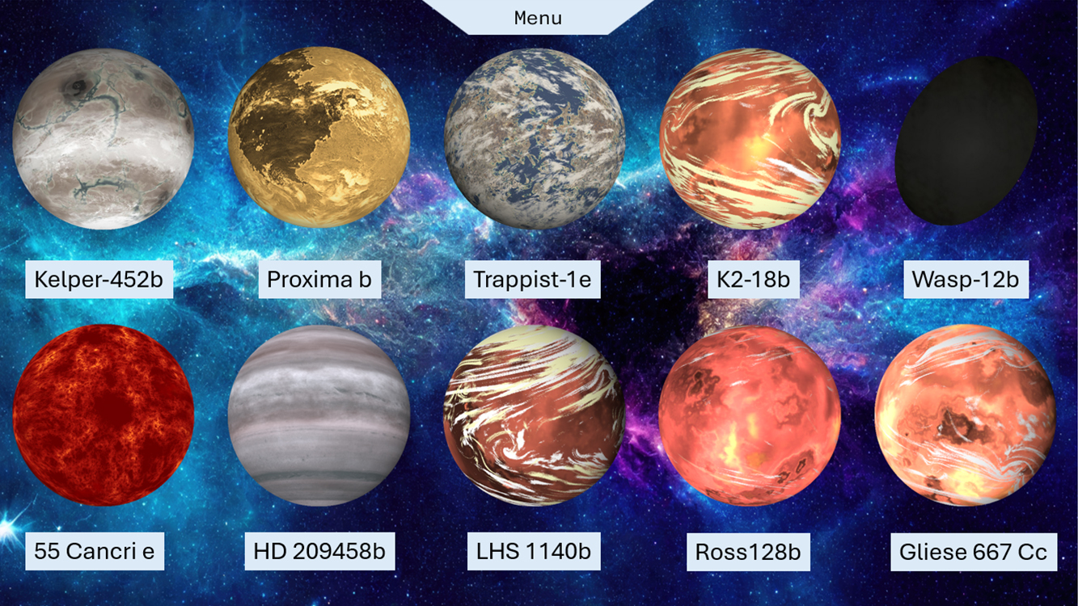
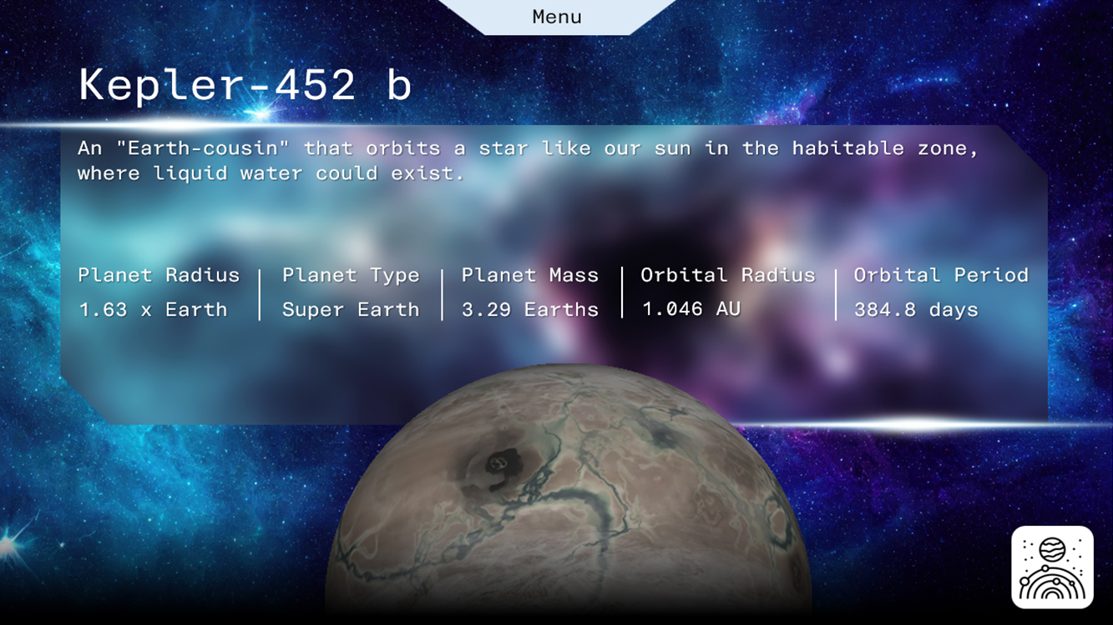
Moving beyond our solar system, we explore 10 exoplanets , planets that orbit stars outside of our solar system. Similar to the dwarf planet section, each exoplanet is presented as a clickable button that leads to its own slide . Each exoplanet’s slide includes a brief summary, covering vital information such as the planet’s radius, type, mass, orbital radius (the distance from its host star), and orbital period (the time it takes to complete one orbit around its star). For instance, you will learn about Kepler-452b, an Earth-sized exoplanet in the habitable zone of its star, as well as gas giants like HD 209458b, which has been observed to have a significant atmosphere.

Slide 5
This demo aims to give you a brief insight into the larger presentation, which goes into greater depth regarding the nature of these celestial bodies. By the end of the full presentation, you will have a greater appreciation for the diversity of planets, both within our solar system and beyond. The dynamic hyperlink buttons offer an interactive way to explore each planet at your own pace, providing a user-friendly experience for anyone curious about the final frontier.
Thank you for your attention, and we hope you enjoy exploring the wonders of our universe through this presentation on exoplanet exploration . Here are some important slides in our presentation ;

Slide 6
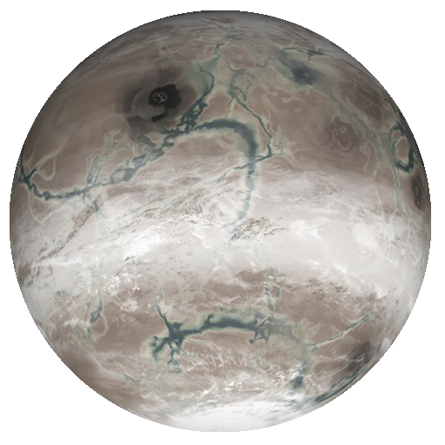
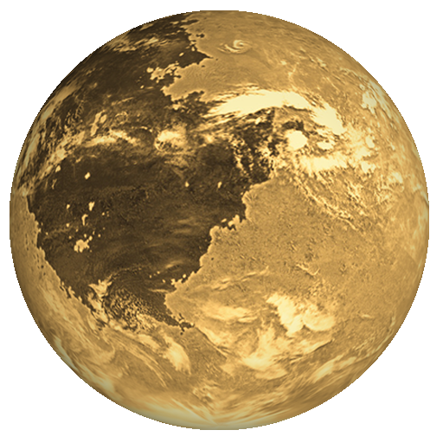
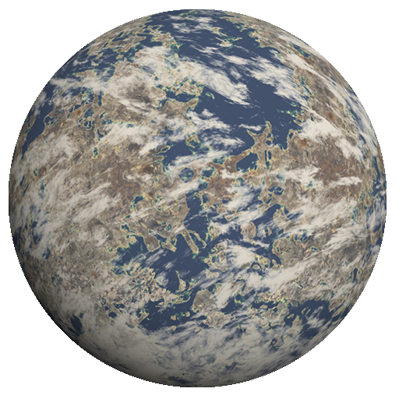
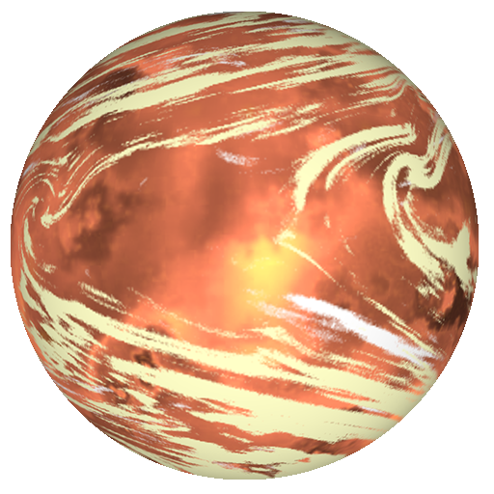

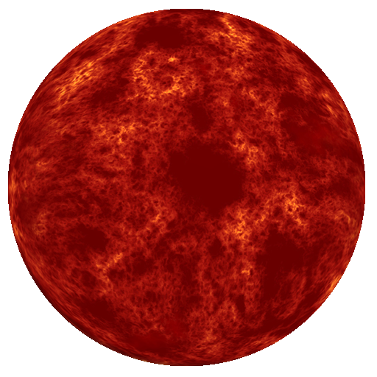
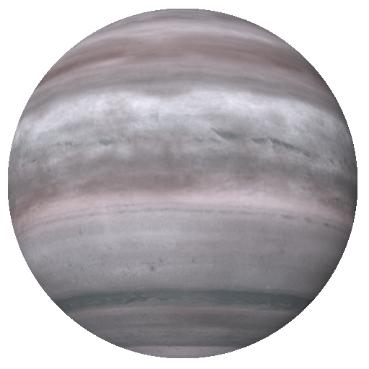
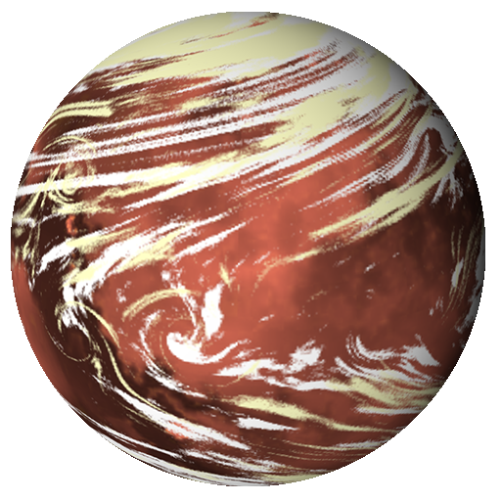
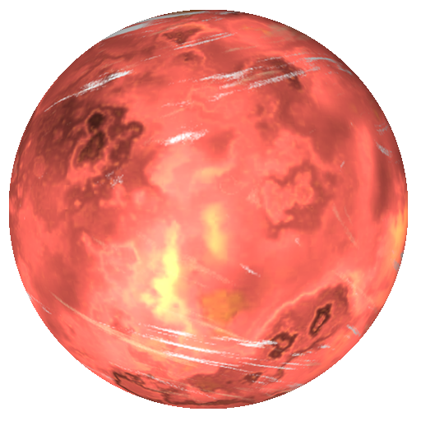
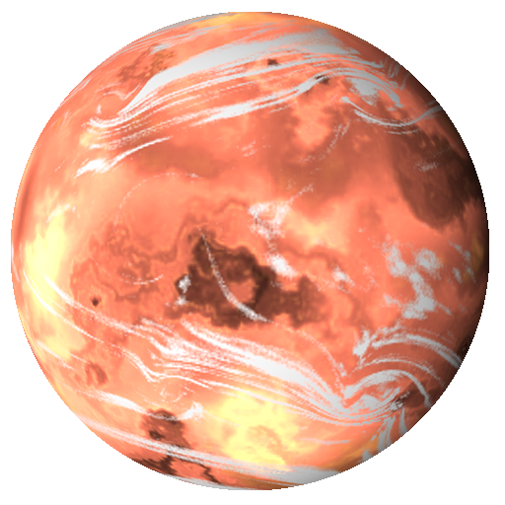
Menu
Kelper-452b
Proxima b
Trappist-1e
K2-18b
Wasp-12b
55 Cancri e
HD 209458b
LHS 1140b
Ross128b
Gliese 667 Cc

Slide 7



Menu
Kepler-452 b
An "Earth-cousin" that orbits a star like our sun in the habitable zone, where liquid water could exist.
Planet Radius
Planet Type
Planet Mass
Orbital Radius
Orbital Period
1.63 x Earth
Super Earth
3.29 Earths
1.046 AU
384.8 days

